Slide 1




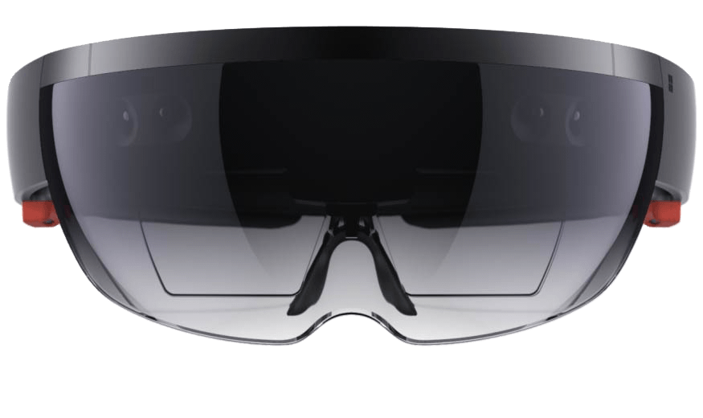
A little about me
June Cho
Enterprise Mobile App Developer
juc@microsoft.com
www.linkedin.com/in/chojune/

Slide 2





Visual Studio App Center
Continuous Everything – Build, Test, Deploy, Monitor, Repeat.

Slide 3




Businesses are rapidly appifying
Silicon Valley is coming. We are going to work hard to make our services as seamless and competitive as theirs.
“
We are putting 70% of our applications in the cloud to improve flexibility. And, we are launching truly game-changing applications to improve efficiency.
“
Walmart is re-defining the next generation of retail growth and is the best-positioned retailer to win at the convergence of digital and physical retail.
“
It's about looking ahead to the changes coming to the automobile business, particularly from potential ‘disruptors’ in Silicon Valley - and preparing Ford to thrive through those changes.
“
Jamie Dimon CEO, JP Morgan
Jeffrey Immelt CEO, GE
Doug McMillon CEO, Walmart
Mark Fields CEO, Ford Motor Company
Notes:
Disruption affects every industry and no company is safe.
Half of the companies that were on the Fortune 500 in 2000 are now gone, replaced by organizations that deliver value faster, better, and cheaper – and the current Fortune 500 faces very much the same fate.
Technology plays a central role in the disruptors‘ ability to execute better.
But it’s no longer just the unicorns that disrupt – increasingly, companies you might not associate with the cutting edge of IT have recognized they need to invest in new technology.
‘Traditional’ companies are using cloud technology and investing in mobile to stand out.
To future-proof their business, we see enterprises embracing innovation and new ways of working to mitigate threats from newcomers.

Slide 4

Businesses create a multitude of apps
CUSTOMER APPS
SUPPLIER APPS
EMPLOYEE APPS
Customer Service
Product Info
My Account
Purchases
Loyalty
Orders
…
Order Management
Procurement
Dashboards
Inventory
Resellers
ERP
…
Health Services
Onboarding
Recruiting
Benefits
Payroll
Travel
…
Notes:
Many businesses have already started their journey to mobile with consumer apps some time ago, so they are familiar with some of the biggest challenges.
When the iPhone came out there was ‘an app for that’.
And now the same thing is happening across every aspect of the modern business.
Businesses are realizing that in order to be successful and thrive they will have to support not just one mobile app but a multi-app mobile strategy.
We call this the appification of modern business – the proliferation of targeted, highly optimized apps designed for a particular group of users or specific task or purpose.

Slide 5
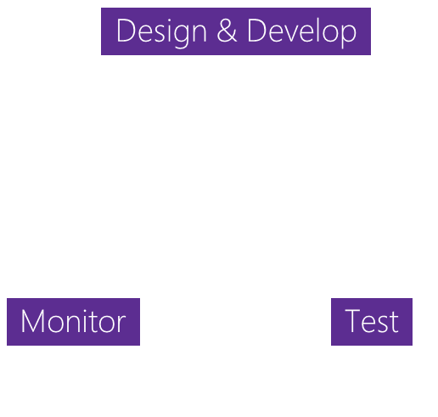

App development challenges
SCALE
COMPLEXITY
FRAGMENTATION
Design & Develop
Monitor
Test
100+ apps
Businesses need to rapidly build and deliver high-quality mobile apps
App Delivery
The lifecycle to deliver ‘just one’ app involves many stages
1000+ Devices
Mobile ecosystems are complex with many combinations of devices
Notes:
Many companies have built their first few apps, but those numbers are growing. As one app turns to tens or hundreds this introduces greater complexity to the development process as companies look to not only maintain the apps they have, but also introduce new ones.
Additionally, as companies look to create these applications, they still need to consider what devices their users have, and it can be extremely difficult to develop for all those different possibilities.

Slide 6






HockeyApp
Xamarin Test Cloud
Xamarin Insights
Distribution • Crashes • Analytics
Device Tests
Crashes • Analytics
Visual Studio App Center
Azure Mobile Engagement
Azure App Service
CodePush
Analytics • Push
Tables • Auth • Push
Distribution
Notes:
Talk about how our teams and product came together.
Here at Microsoft we offer services like HockeyApp for distribution, Xamarin Test Cloud for automated device testing and Azure Mobile Engagement for targeted push notifications. As we saw managing multiple applications can become unwieldy, we took these Microsoft products and brought it all together creating Visual Studio App Center.

Slide 7
Visual Studio App Center
Continuous integration, delivery and feedback for iOS, Android, Windows, and macOS apps.
Ship 5-star, higher-quality apps faster with confidence.
Notes:
Visual Studio App Center is your continuous integration, delivery and learning solution for Android, iOS, Windows, and macOS apps. A place where all these service seamlessly integrate to make the cycle easier and faster for developers. You now have an end-to-end solution where you can either use all the services offered or pick and choose the ones you want.

Slide 8
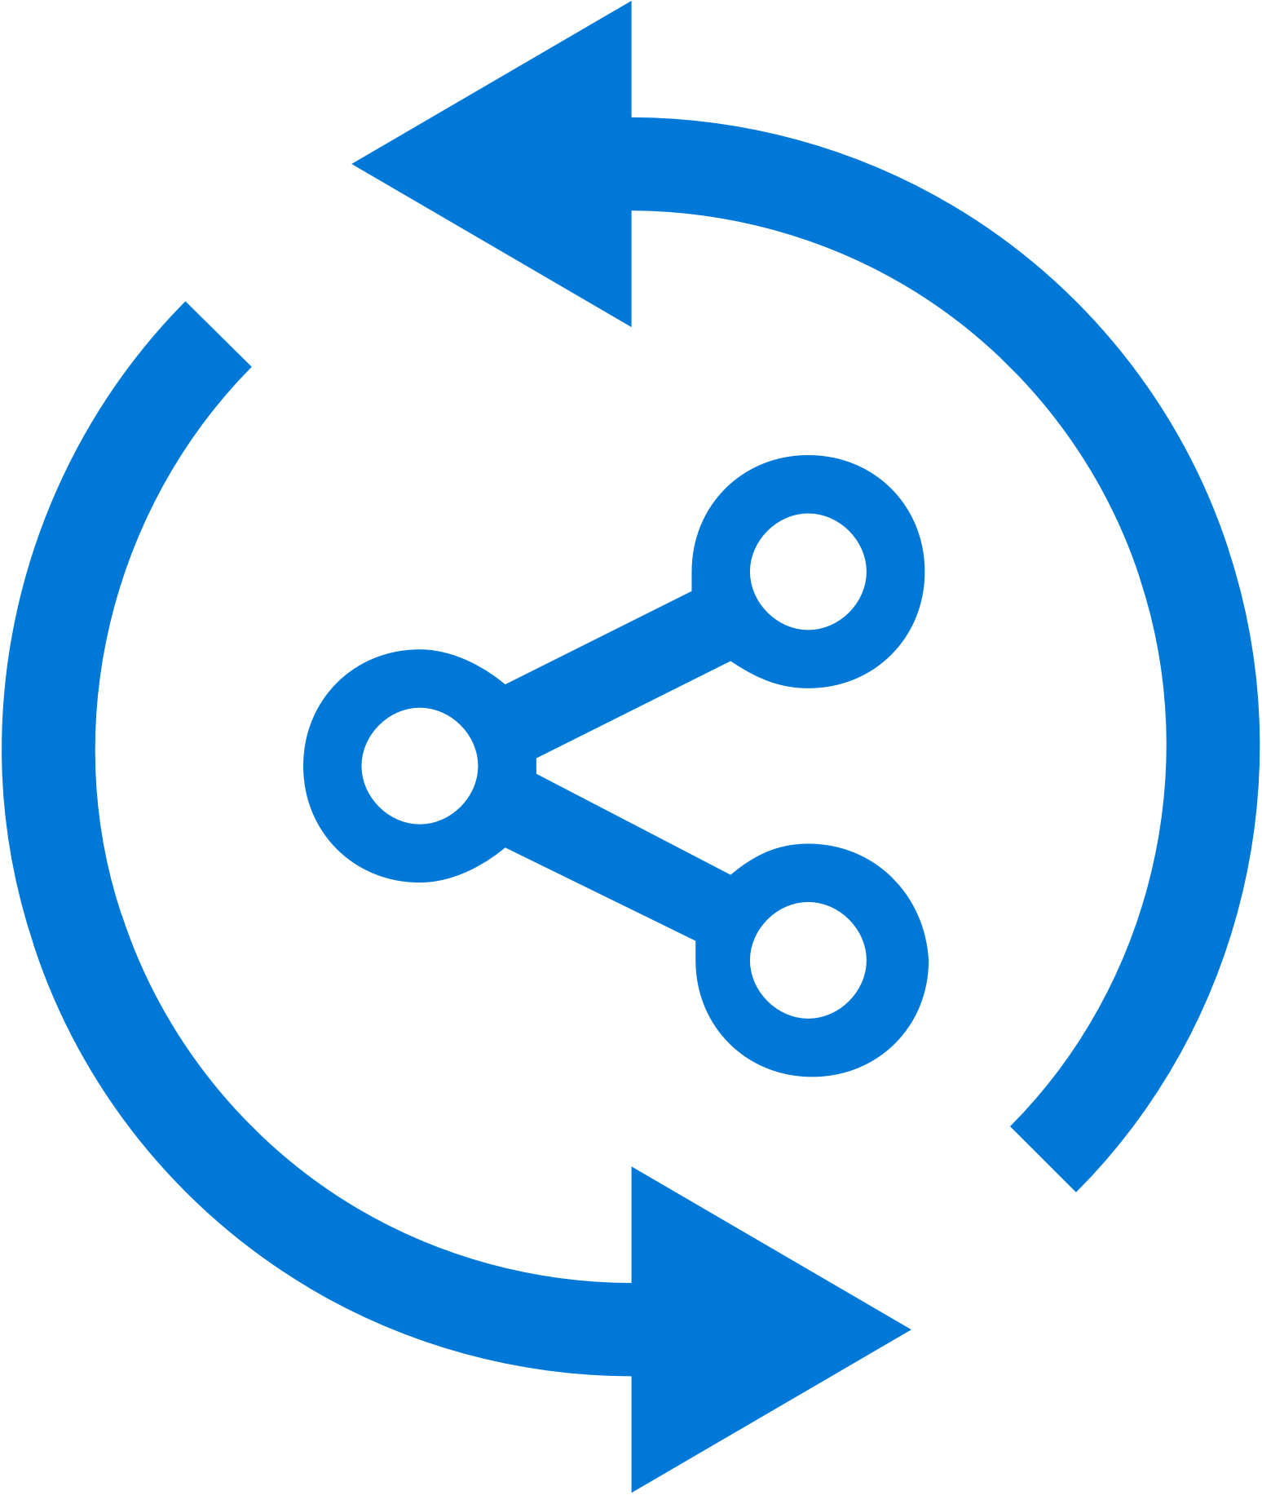


Continuous integration in minutes
Build-on-push
With just a few steps automatically build apps with every commit, and generate packages to test and distribute
Work with existing tools
Connect existing repositories in GitHub, Bitbucket, and Visual Studio Team Services with just a few clicks
Build securely in the cloud
Each build is run on a separate, clean virtual machine hosted on our secure cloud servers
Notes:
The Build functionality allows you to connect your existing code repositories, like VSTS, GitHub and BitBucket and configure them to run automatically on code submission, or on a timed schedule, regularly staying up to date on the health of your build. This is all done on the cloud, so you don’t have to manage any hardware locally.

Slide 9



Continuous quality on real devices
Release faster
Shrink release times significantly and push new apps out faster
Ship high-quality apps Ensure the highest quality user experience that keeps users continuously engaged
Engage a broad audience
Test on a broad range of devices to make sure apps work on your users’ devices
Create new features Spend less time fixing bugs, and more time creating value
Notes:
App Center’s testing solution starts with our device lab with over 300 configurations and thousands of individual Android and iOS devices that you can run your developed UI Automation scripts. We support scripts written in a variety like UITest, Appium or the native Espresso and XCUITest. Run your app on real devices without, again, maintaining the hardware, and getting live results to know your app is bug free.

Slide 10
Get Started Free Today aka.ms/vsappcenter

